Slide 1


ACE: Just-in-time Serverless Software Component Discovery Through Approximate Concrete Execution
By Anthony Byrne¹, Shripad Nadgowda², and AYSE K. Coskun¹
¹Boston University; ²IBM T.J. Watson Research Center
Sixth International Workshop on Serverless Computing (WoSC6)
December 8, 2020
Full paper available at www.serverlesscomputing.org/wosc6/#p7

Slide 2
Serverless Containers: More Than Just FaaS
“Serverless computing” encompasses more than Lambda functions
FaaS requirements (language, runtime, etc.) too strict for many developers
Cloud providers offer serverless container platforms as a compromise
“Just hand us your Docker image, and we’ll handle everything else”
Bestow serverless benefits on any containerized app: scaling, billing, etc.
Allows executables not typically found in FaaS: compiled C/C++/Go binaries

Slide 3
What Could Possibly Go Wrong?
Cloud apps often made of in-house and off-the-shelf parts
Libraries, microservices, helper tools, etc.
“Undesirable” software components key to many scandals
OpenSSL: Heartbleed bug exposed 66% of web servers (2014)
Apache Struts: 143 million Equifax records breached (2017)
Several court cases regarding licensing (e.g., AGPL)
Binaries harder to screen for undesirables than Python/Java/JS code
No “requirements.txt” or other component manifest, just 1’s and 0’s
How can we discover software components in serverless binaries?
Notes:
“Don’t reinvent the wheel”
OWASP Top-10 Security Risks (#9 on 2017 list)
AGPL: ghostscript PDF renderer (Hancom vs.
eslint-scope: 4,500 NPM authentication tokens stolen (2018)
Eslint: https://www.theregister.com/2018/07/12/npm_eslint/
M. Ohm, H. Plate, A. Sykosch, and M. Meier, “Backstabber’s Knife Collection: A Review of Open Source Software Supply Chain Attacks,” in Lecture Notes in Computer Science (including subseries Lecture Notes in Artificial Intelligence and Lecture Notes in Bioinformatics), vol. 12223 LNCS, 2020, pp. 23–43.

Slide 4
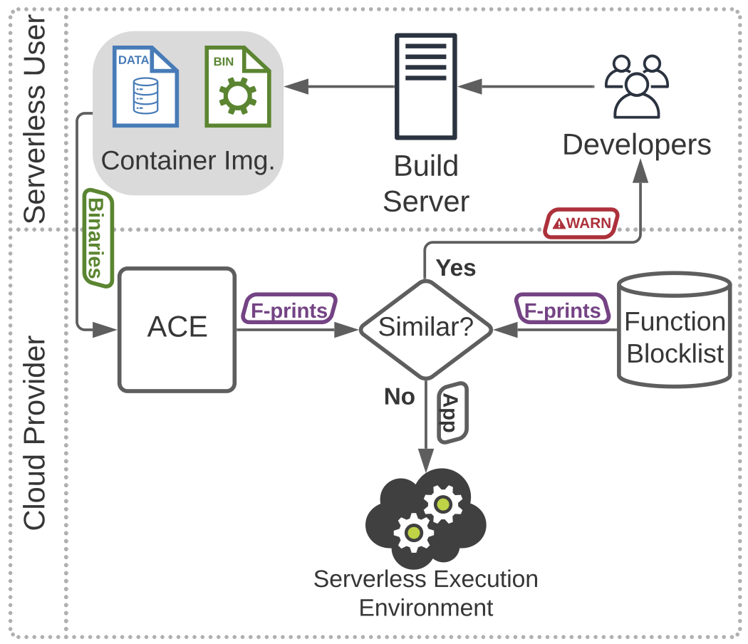
Just-in-time Component Discovery for Serverless
Serverless gives cloud providers unprecedented access to developers’ applications
Use it for good by scanning apps “JIT” before harm occurs
Serverless binaries present special challenges
Metadata stripped and obscured through static linkage
Most analysis techniques slow and error-prone
Binary function fingerprinting provides a framework
Disassemble binaries, fingerprint functions, check blocklist
If fingerprint similar to “known bad” one, then flag for review
JIT Component Discovery
Function Finger-printer
How can we fingerprint a binary function?
Notes:
I get caught on this slide quite a bit (may fix itself with removal of prev. slide)
provides a framework to the solution to our challenges

Slide 5
Introducing Approximate Concrete Execution
push r1
mov r2, 5
jnz 0x56
jcc r4, 56
sub r0, 8, r0
stm r1, r0
str 5, r2
bisnz r4, r3
jcc r4, 56
REGISTERS
r0 = 10
r1 = 10
r2 = 10
r3 = 10
r4 = 10
RAM
0x0 = 0
0x1 = 1
0x2 = 2
0x3 = 3
0x4 = 4
REGISTERS
r0 = 2
r1 = 10
r2 = 5
r3 = 10
r4 = 1
RAM
0x0 = 0
0x1 = 1
0x2 = 10
0x3 = 3
0x4 = 4
Step 1
Disassemble raw binary and determine function bounds
Prior work* provides function bounds in stripped binaries
Step 2
Translate assembly code to IR function-by-function
REIL: simple MIPS-like register layout, infinite memory
Step 3
Filter code and provision a REIL “approximate VM”
Remove all control flow instructions and sort (to account for compiler diffs.)
Step 4
Approximately execute and collect final aVM context
Post-execution reg. values become fingerprint
* D. Andriesse, A. Slowinska, and H. Bos, “Compiler-Agnostic Function Detection in Binaries,” in 2017 IEEE European Symposium on Security and Privacy (EuroS&P), 2017, pp. 177–189.

Slide 6



Evaluating ACE for Serverless: Goals
A JIT serverless binary fingerprinting method must…
produce representative fingerprints resistant to compiler variations
introduce very little overhead to the serverless environment
be tunable to different users’ needs and applications

Slide 7
Evaluation
Accuracy: find the undesirable function
Inject dummy function into ~230 C/C++ cloud apps
Compile clean & injected apps and disassemble
Classify each of the 37k functions using ACE
Positive: exact match to known dummy fingerprint
Overhead
5.2x faster end-to-end than baseline
Most functions fingerprinted in <10 milliseconds
ACE requires no pre-training
Learning-based methods like SAFE require training and constant updating of ML models
Minimal overall impact on cold-start or deployment latency
Notes:
217 different versions of raw string for dummy function

Slide 8
Why ACE for Serverless Component Discovery?
Speed
No model training
No complex instruction emulation
5.2x faster end-to-end
Resiliency
Code filtering mitigates compiler variations
99% accurate binary classification of undesirable code
Versatility
Several variables (sensitivity, aVM register size, etc.) tunable to users’ needs
Output vector suited to almost any search technique

Slide 9

Concluding Remarks
Serverless container platforms vulnerable to problems with undesirable software components
ACE enables just-in-time discovery of these components through binary function fingerprinting
We’re excited to see future work apply the aVM to further improve serverless performance & security
More info at bu.edu/peaclab
Please send feedback to abyrne19@bu.edu
This work has been partially funded by IBM Research

